Slide 1
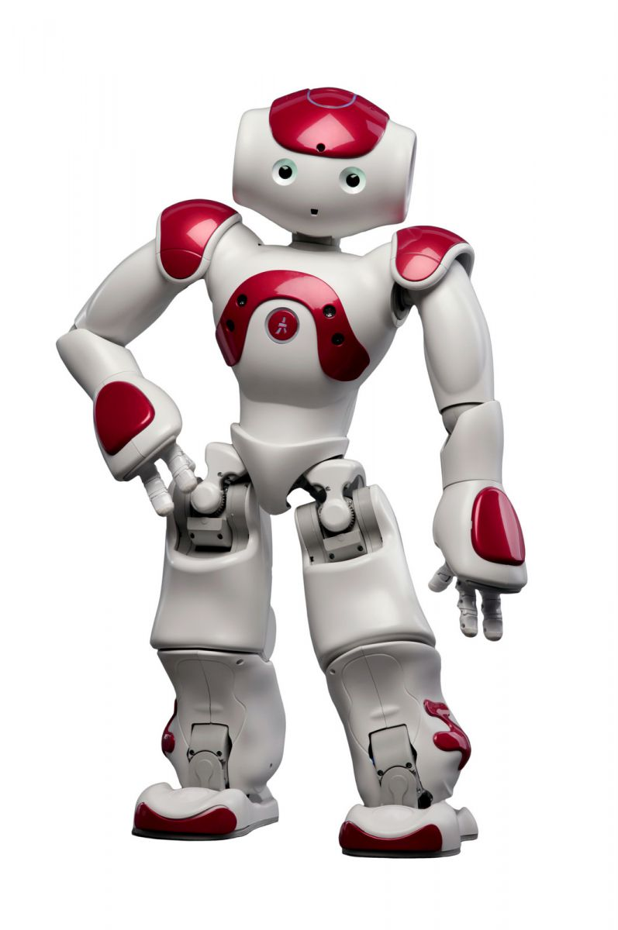


Field Limits Detection
ROS
Nao v5
OpenCV
Nektarios Sfyris – Autonomous Agents

Slide 2
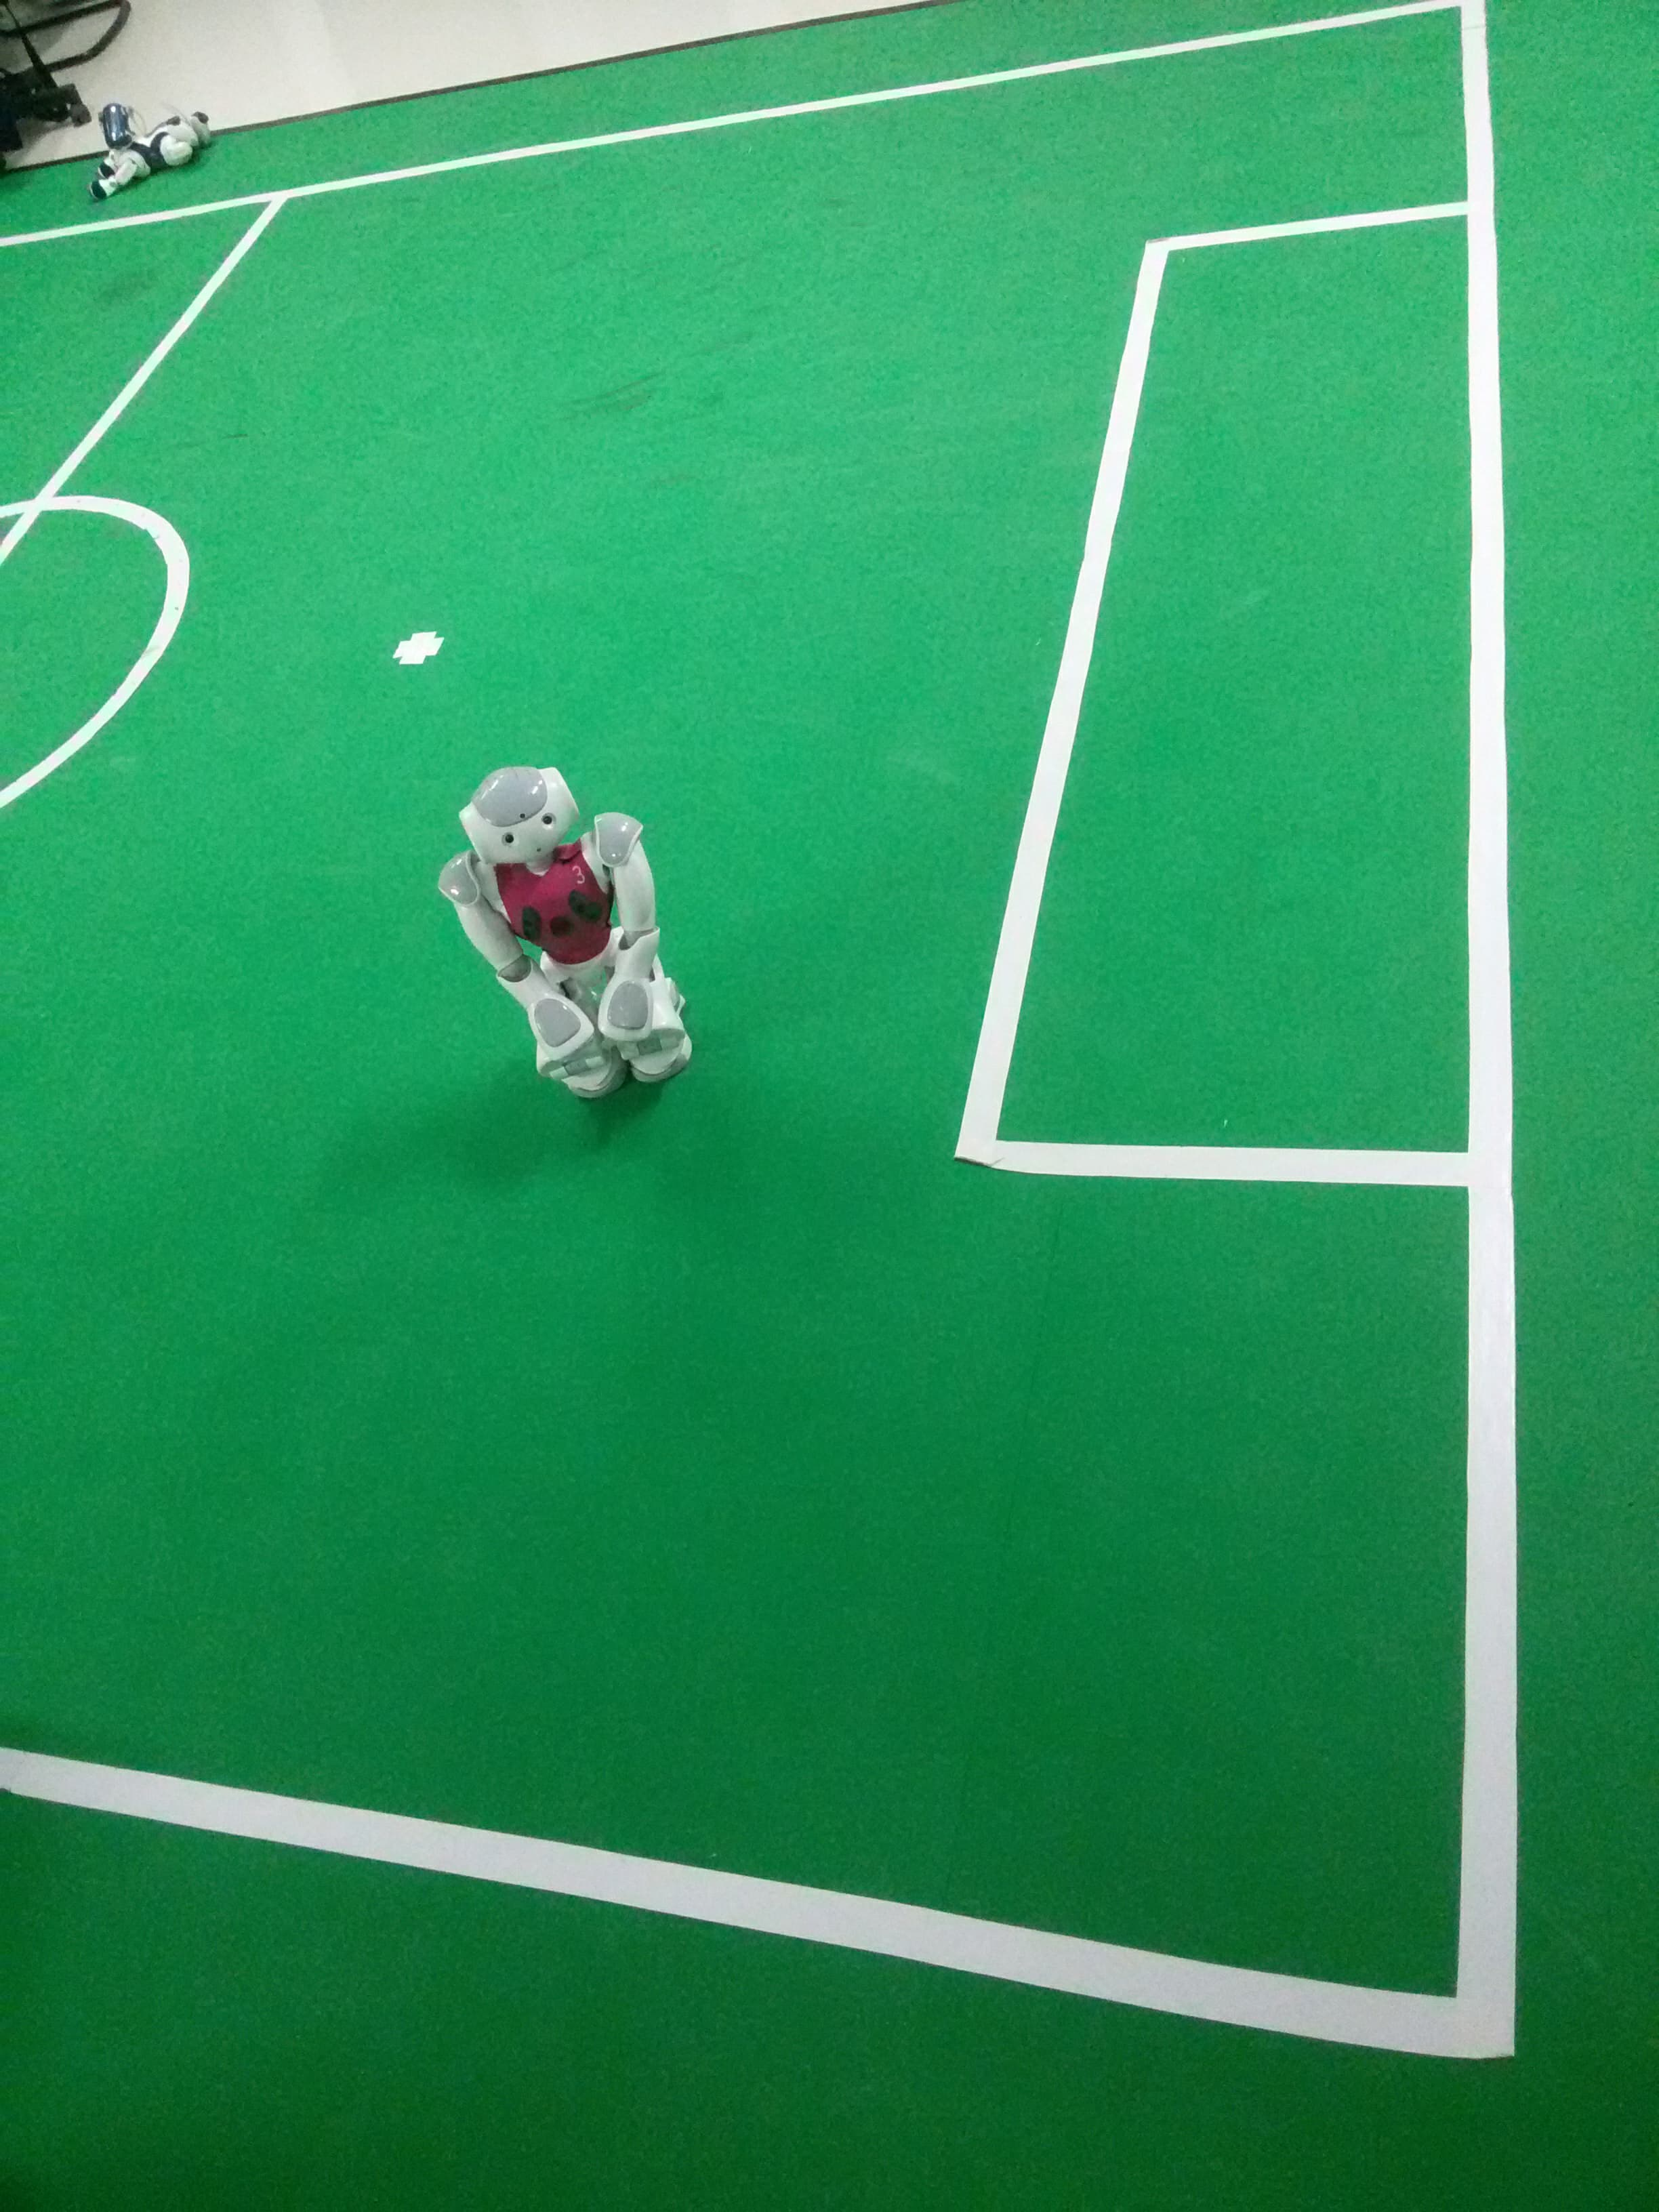
The Project
In this project, we will attempt to
make Nao understand where the
limits of the field it will be in are,
and make it stay behind those
limits. We split the work in two
nodes. One for image processing
and one for moving the Nao.
The field we will work on is at the
Intelligent Systems Laboratory of
Technical University of Crete :

Slide 3
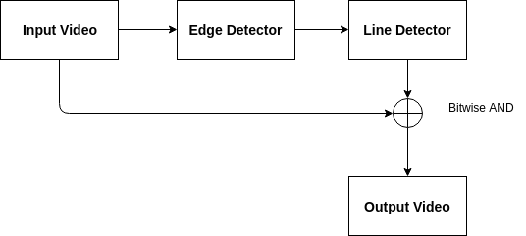
Line finder Node
This node is responsible for finding the lines in front of Nao
and after applying a filter to pick only the ones that are unique, it publishes them. Those lines will be used by the Mover Node later. The system implemented is the following :
The lines are being published as a
message having their starting and ending
points, and also the line’s factor.

Slide 4
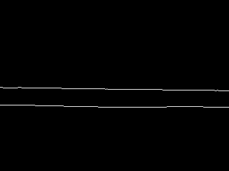
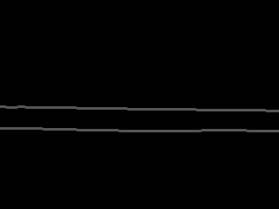
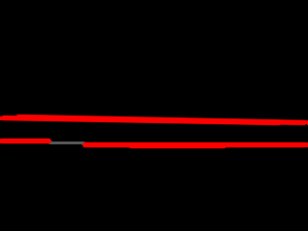
Line finder Node
The stages of the image processing are being presented :
Applying the Probabilistic Hough
Transform with the extra filter
for line clarification
Applying the kernel 3x3
Blurring
Applying the Edge Detector
In every camera frame, the extra filter we added cleans about the 30% of the lines the probabilistic Hough transform produces.

Slide 5
Mover Node
In this node we first subscribe to the topic created by the Line_finder Node. Each line we collect is being checked to see it’s position in relation to Nao. If the line has a negative factor and is in front of Nao, then the Nao turns right handedly to avoid going out of limits and then continues moving forward. Accordingly, if the factor of the line is positive.
This way it will stay in the field’s limits and keep moving freely.

Slide 6
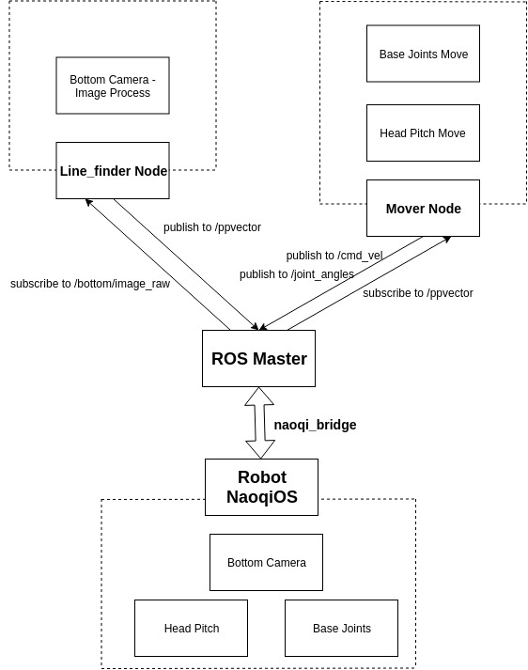
How ROS
and
NaoqiOS
allow communication :

Slide 7
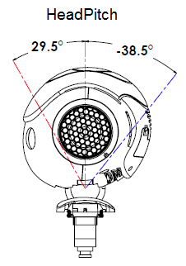
Before and after roslaunch
After every change we make to our project we make sure to build it in catkin workspace. CmakeLists.txt file is for package, nodes, message and service declaration while package.xml is for package dependencies.
Before we do the roslaunch of our project we make sure Nao will look down by publishing a message to the HeadPitch. That message will move its head around 20 degrees front.

Slide 8
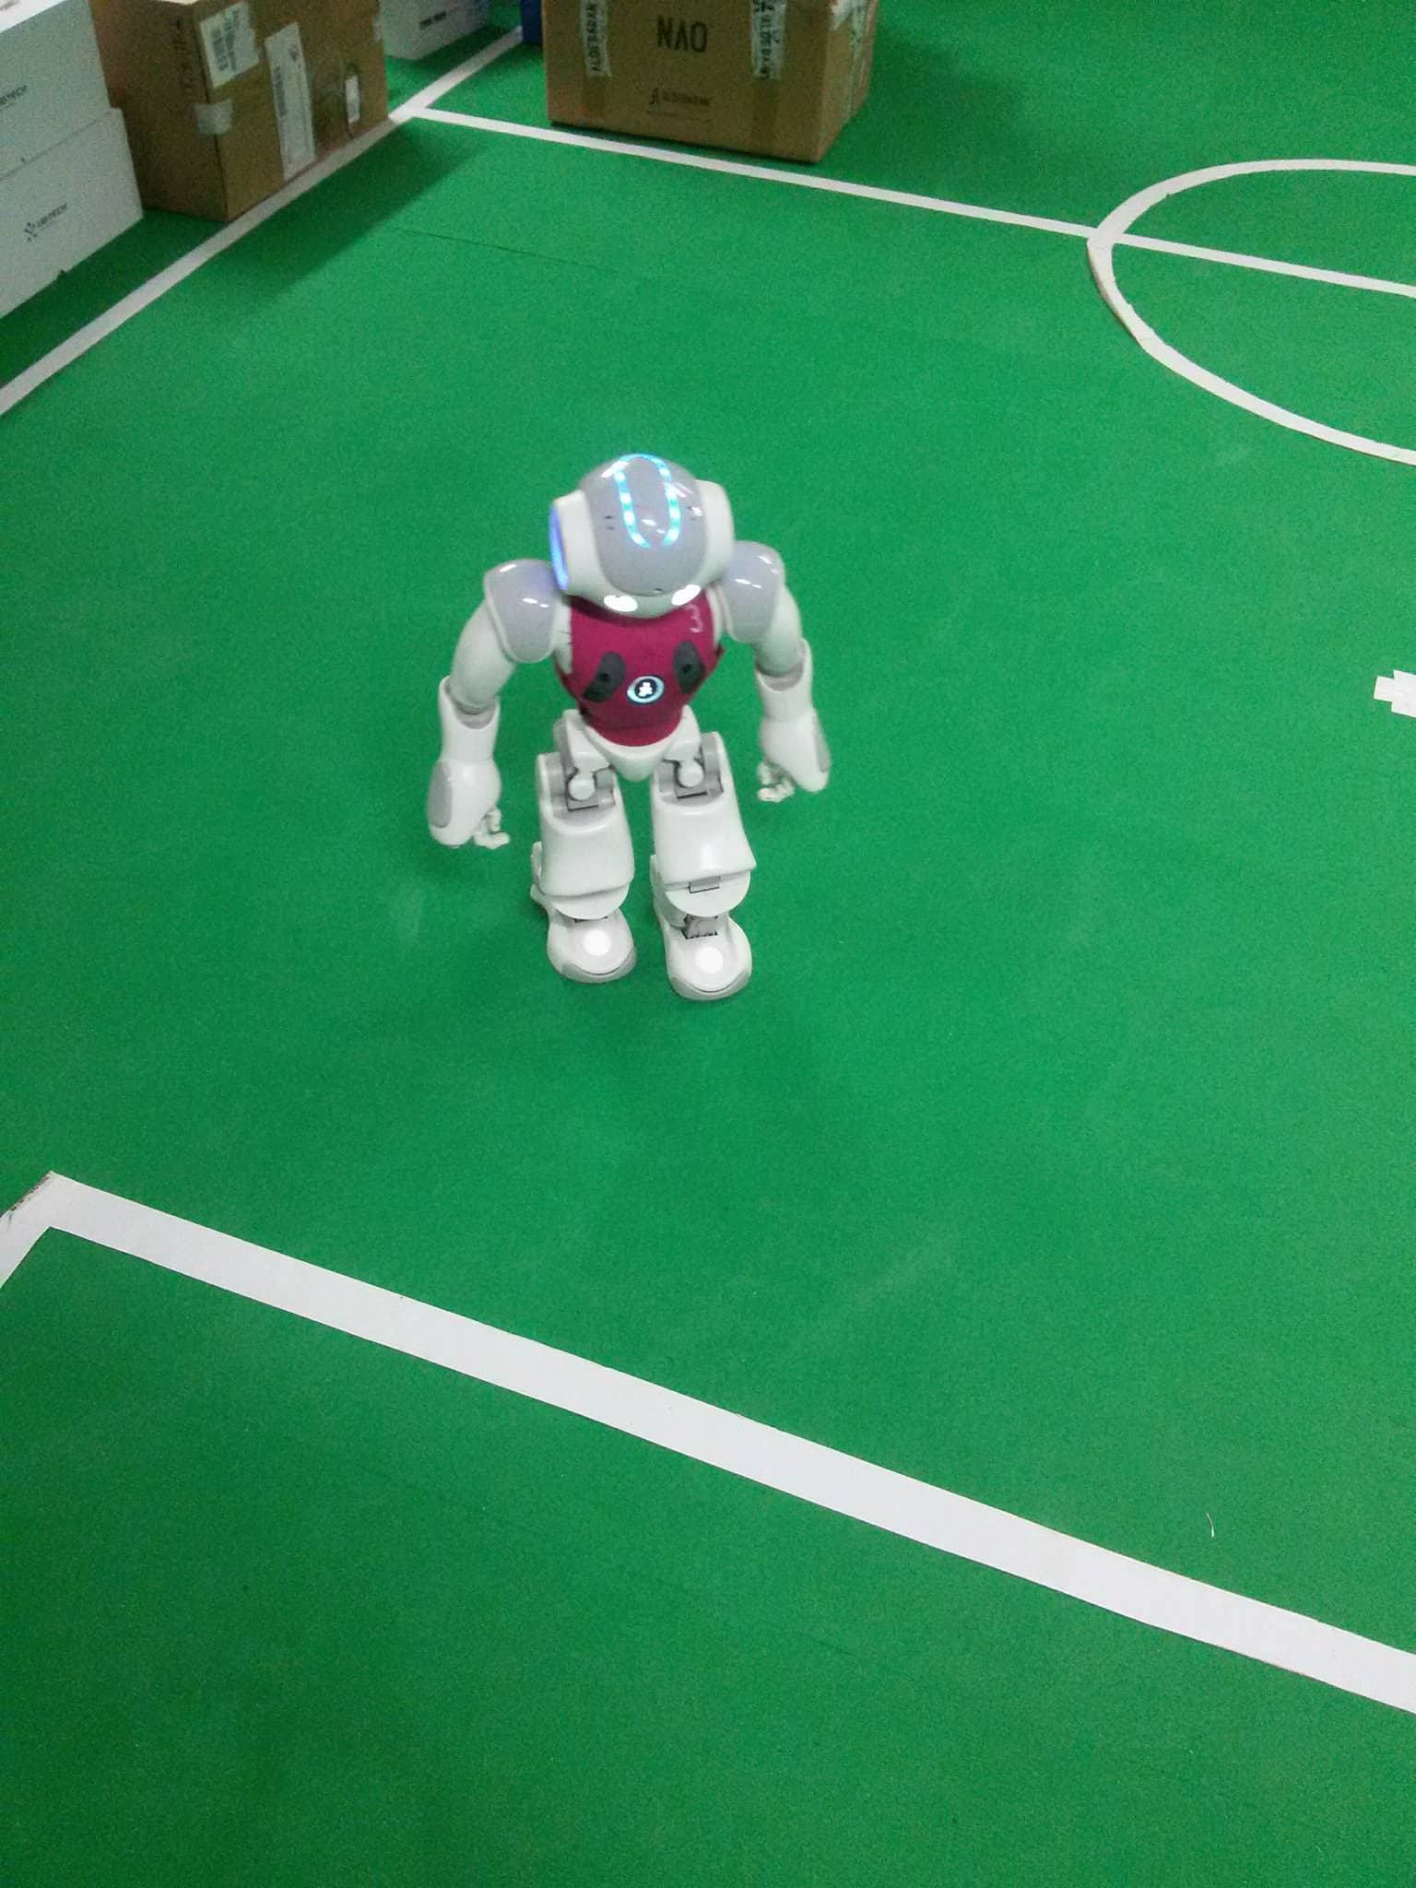
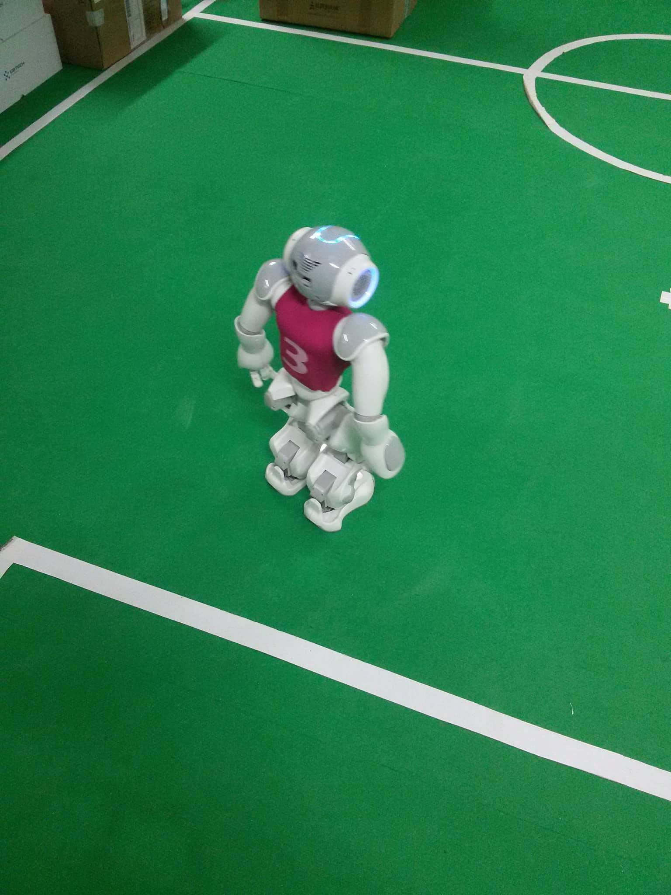
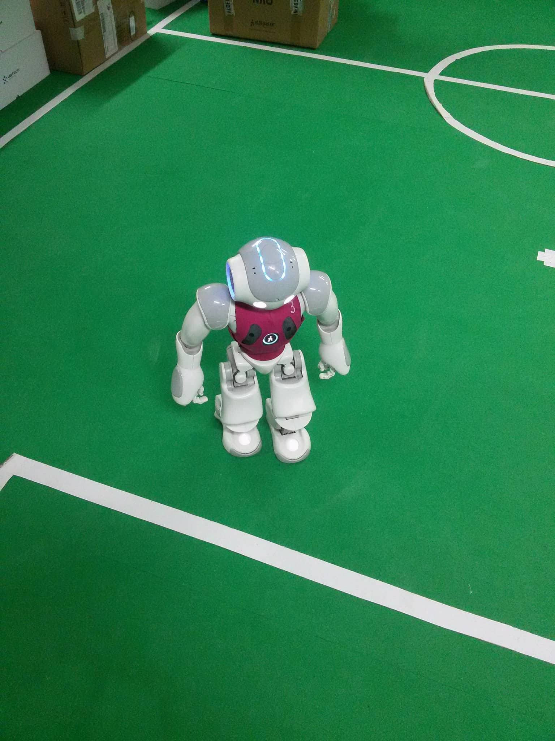
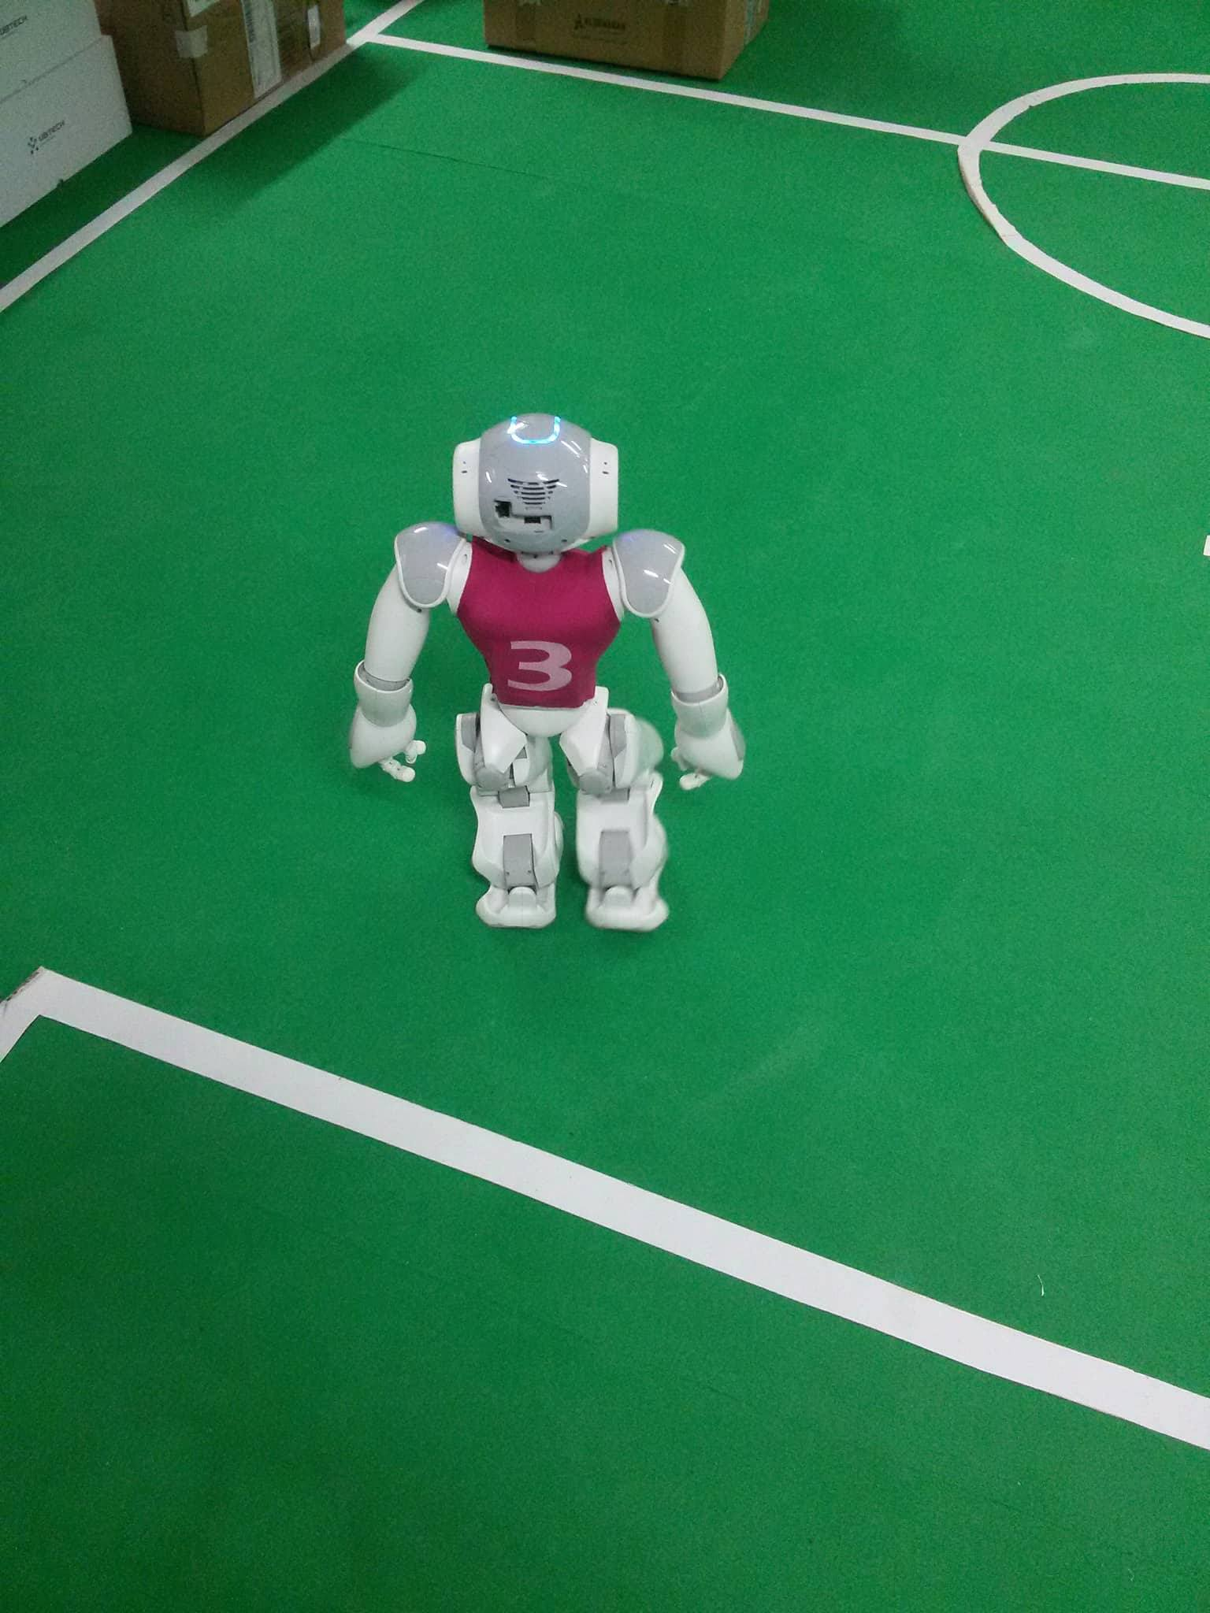
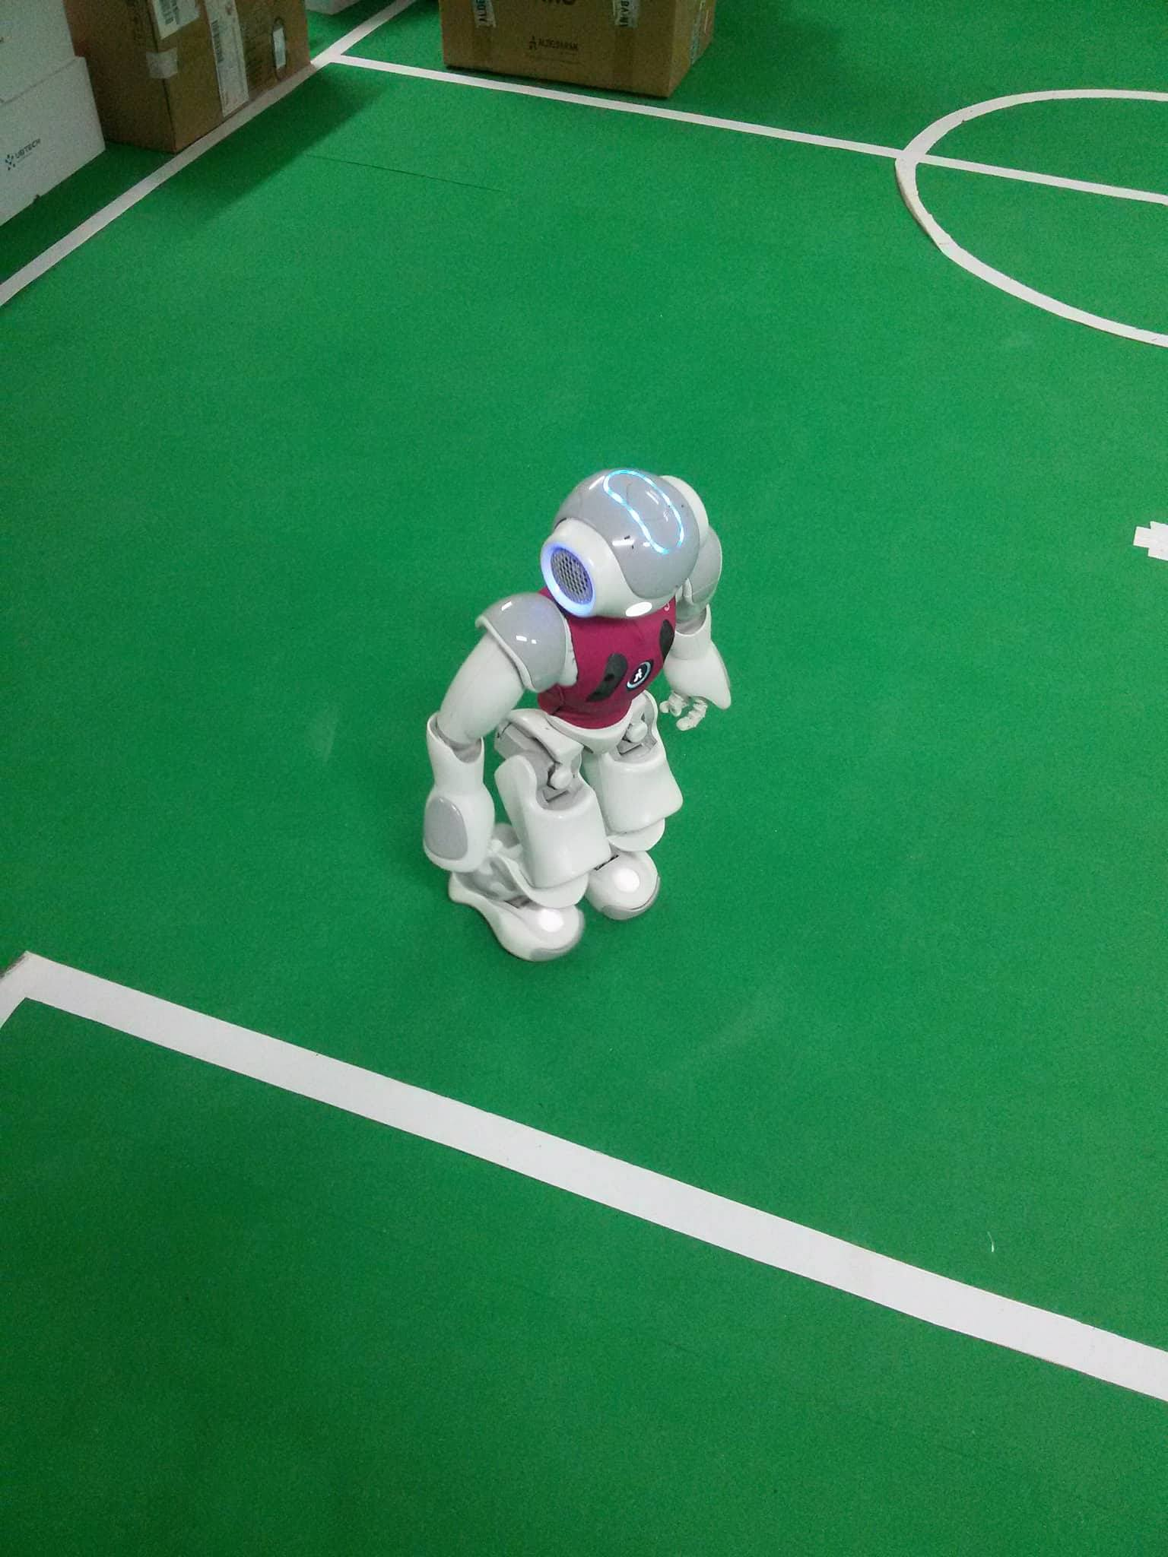
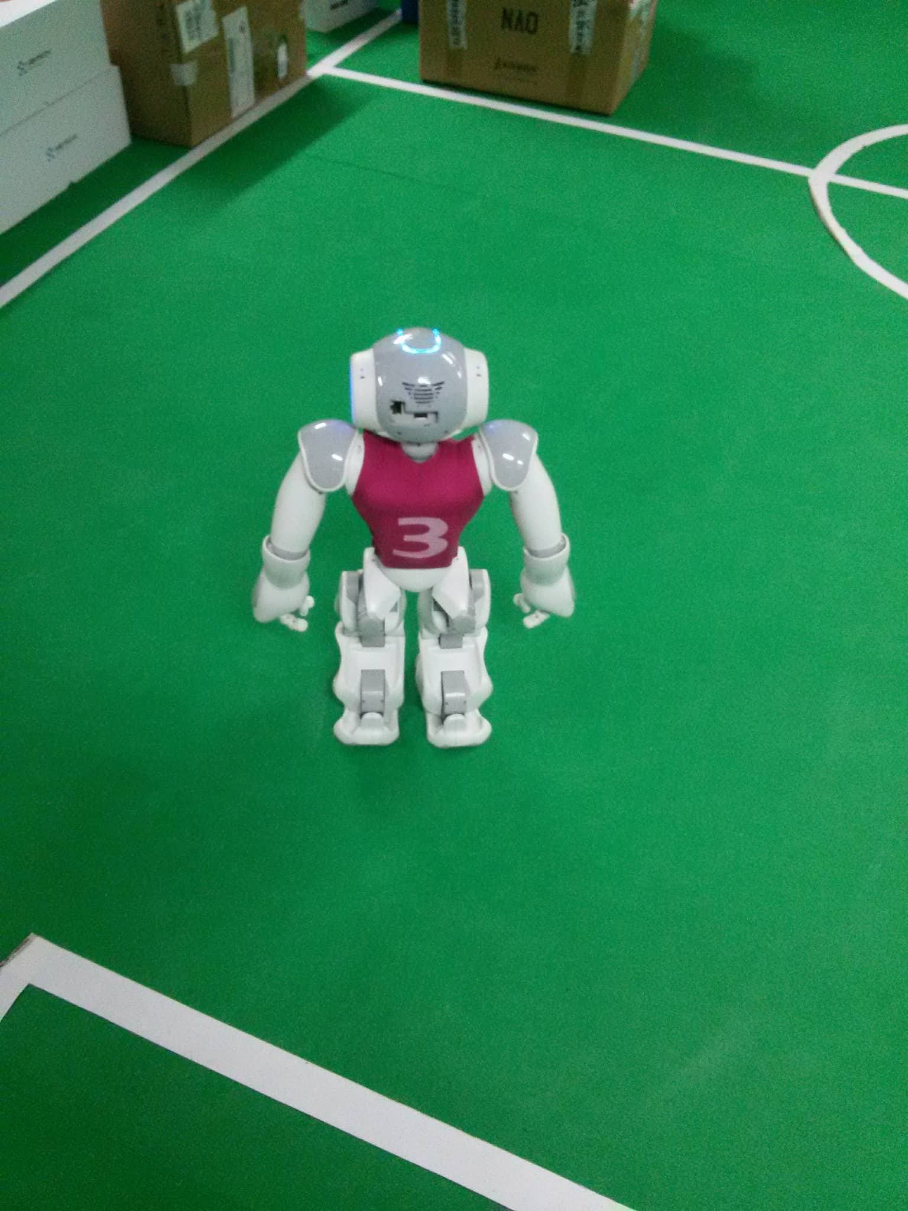
Results & Demonstration
1.
4.
5.
2.
3.
6.

Slide 9
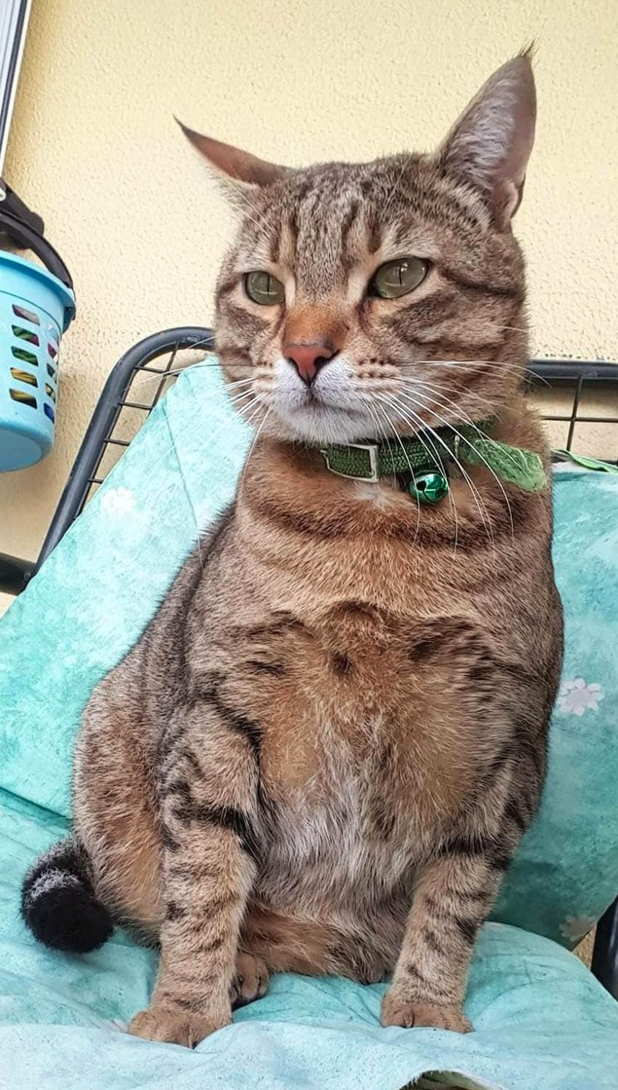
Field Limits Detection
NAO - ROS
Thank you for your time!
Here is a recent photo of my cat!
Nektarios Sfyris – Autonomous Agents

